Slide 1



CHALLENGES AND BUSINESS RECOMMENDATIONS IN AVIATION INDUSTRY
Praveen Kumar Marichamy
SaiKarthik Kandikonda

Slide 2

Motivation
Airline Industry (Ever Booming business)
Trained and Worked in similar domain
Corona Effect
Merger of companies
Flight Price changes

Slide 3

DataSet Details
1.6 gigabytes of space compressed and 12 gigabytes when uncompressed.
Semi- structured
Collection of domestic flights in US April 2010-15

Slide 4
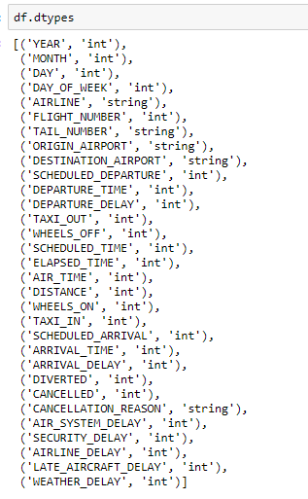

Attributes and Data Types

Slide 5

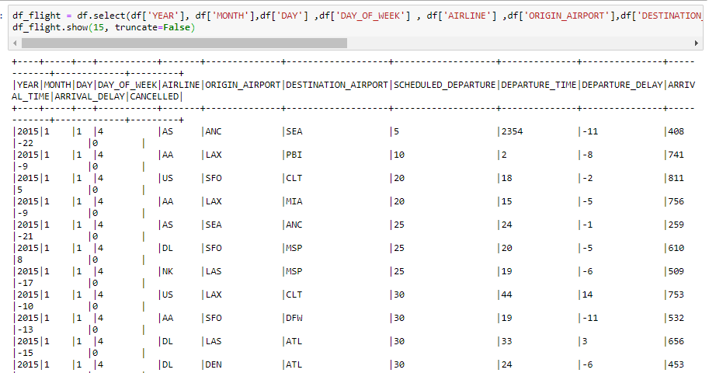
Useful Variables

Slide 6
Problem Statement
1. What would be the best day of the week the day the passenger can choose to fly so that he/she can avoid delays in their journeys?
2. Predicting the top 20 busiest routes in USA and the number of flights travelled in a year
3. Analysis of which month has highest number of cancellations, which helps the passengers in planning their Journey accordingly
4. Predicting the best Airline one can choose between the 2 Places based on the past data. This will help the passenger to get rid of delays and last-minute flight cancellations.

Slide 7
Overview
Data big enough and semi-structure storing of data in MongoDB
Spark RDD containers for Transformations
Pyspark ipython Jupyter notebook
Data being analyzed by using spark sqlcontext
Once the data was cleaned and transformed, we have sent the data in to the MongoDB to store

Slide 8
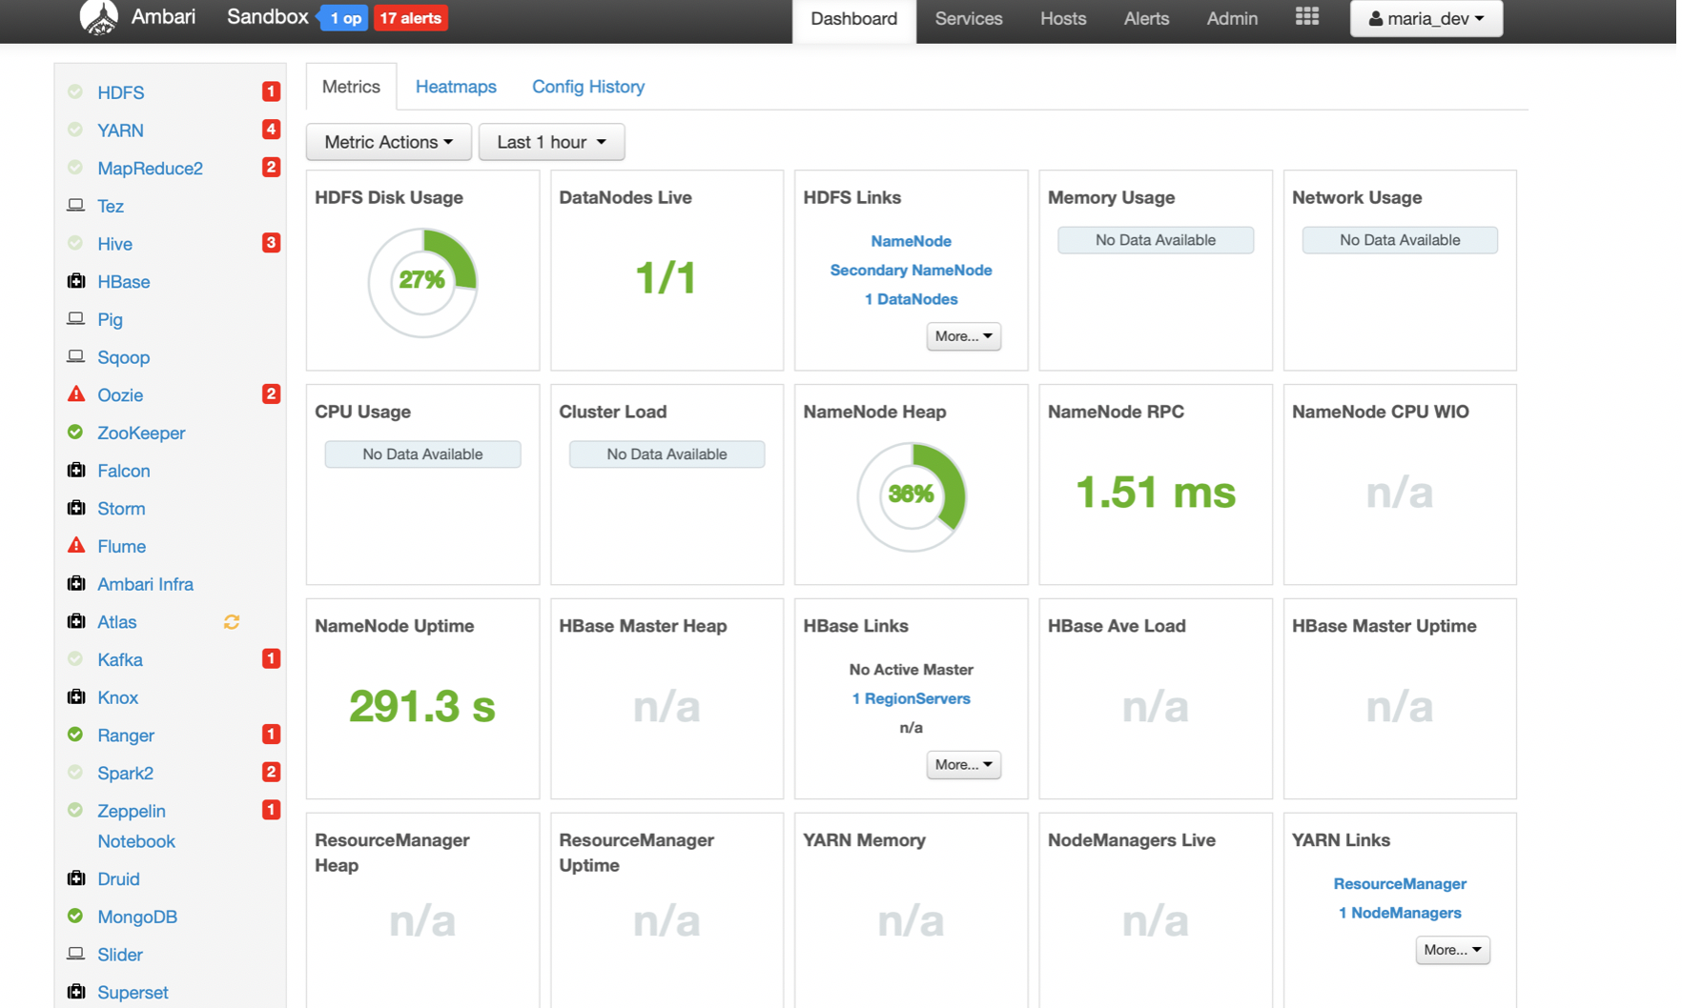
Experimenting in different platforms
AWS
Oracle VMware HortonWorks Platform

Slide 9
Architecture and Data Pipeline Diagram

Slide 10

Jupyter Notebook
Easy to use and Interactive data science environment
Most of the libraries works faster
Run in Chunks

Slide 11
Why Spark
Cluster-Computing framework
Supports Multiple languages
Advanced Analytics other than Map and Reduce
Speed 100 times faster in-memory and 10 times in disk

Slide 12

PySpark
PySpark is an API written for using Python along with Spark framework
The PySpark framework is gaining high popularity in the data science field
data scientists to translate the research code into production code
Parallel execution on all the cores, PySpark is faster than Pandas , PySpark cache data into memory before running queries.

Slide 13
Pyspark Cont..
Distributed computing engine
Stream processing
Default language Scala
Pyspark is a great language for performing exploratory data analysis and building machine learning pipelines too.
Easy to integrate and work with RDD’s in python programming language

Slide 14
PySpark SQL Context:
SQL Context ,running SQL functions, SQL Queries and returns all the outputs/ results as a data frame.
Spark SQL is a spark module for structured data processing and also acts as a distributed SQL query engine.

Slide 15

MongoDB
Document oriented database –Schema Less , Easy to scale
MongoDB is great for transactional stores where performance is a concern (Our’s Airline is similar)
Converted the Pandas DF to JSON DF to load the data into Mongo DB

Slide 16
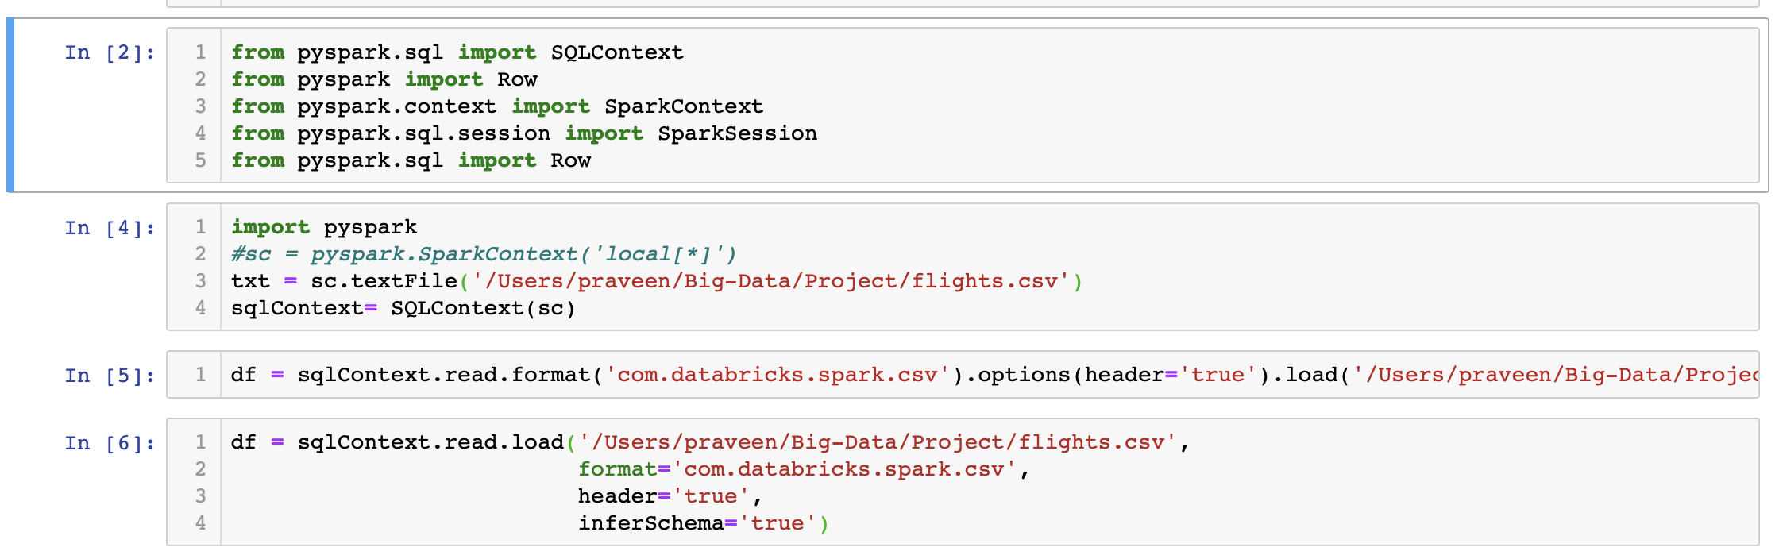
Spark, Pyspark Connector and SQLContext in Ipython Notebook:

Slide 17
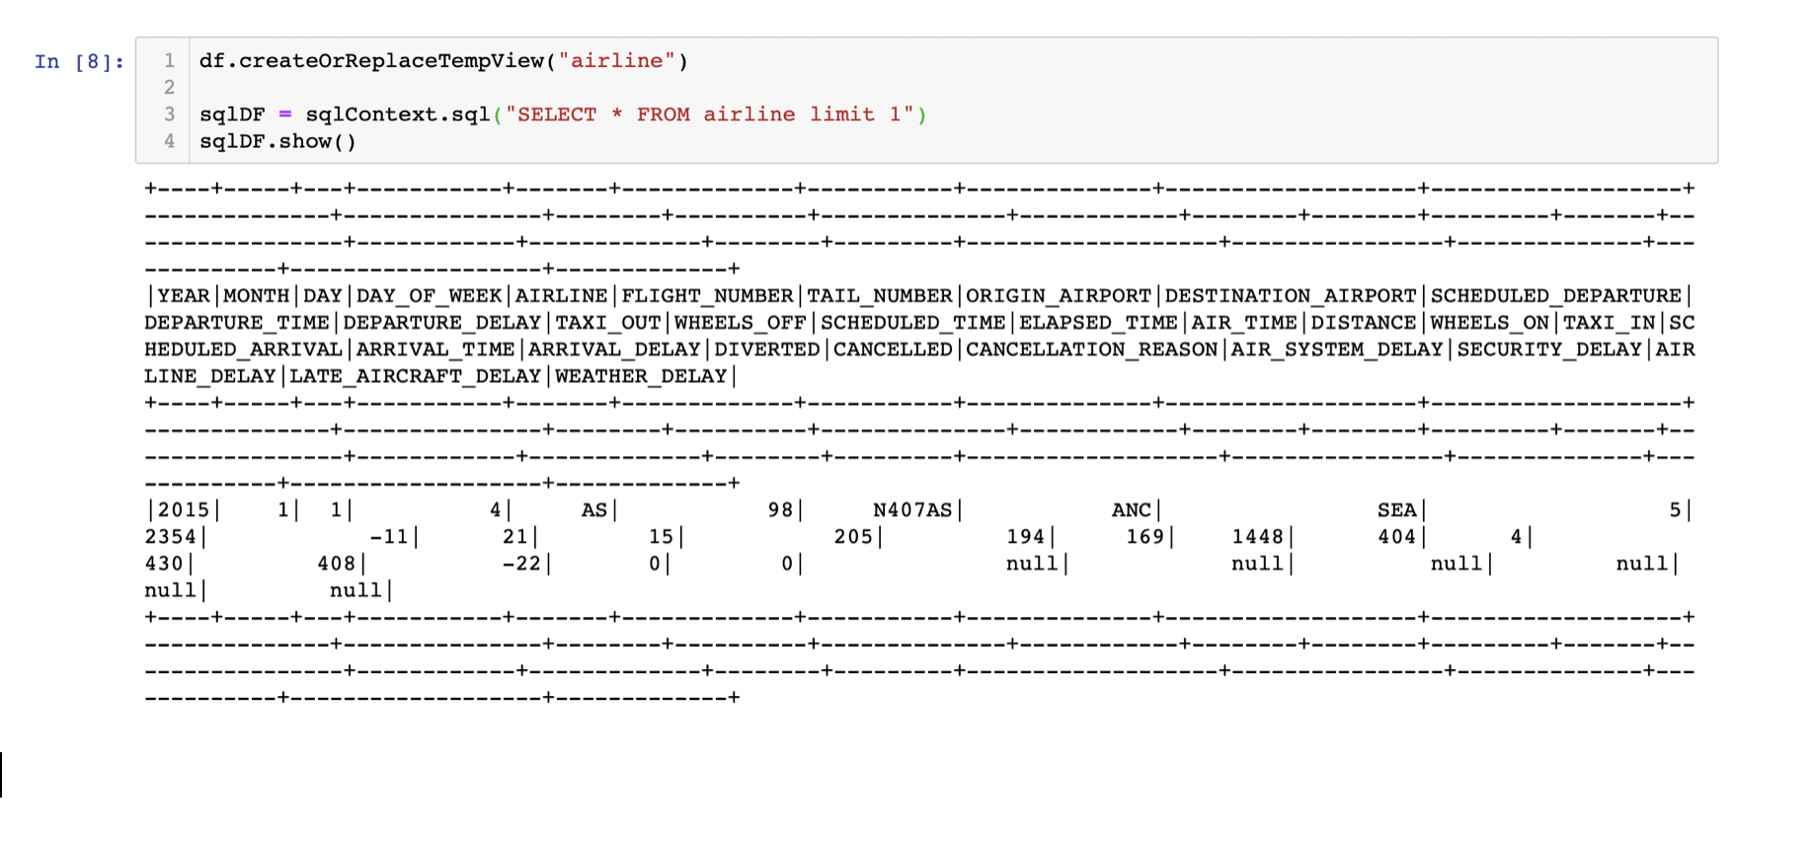
Business Recommendations and Inferences from the Dataset

Slide 18
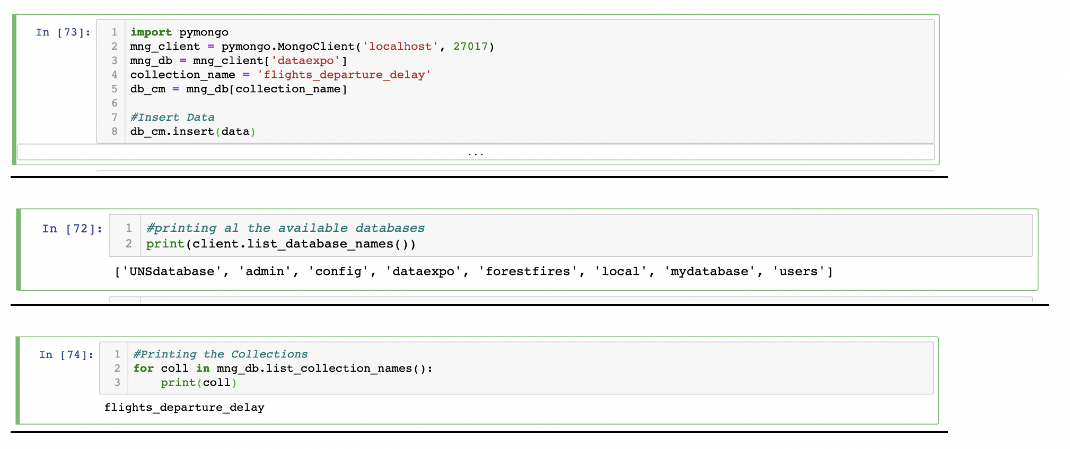

MongoDB Connector in Ipython Notebook:

Slide 19
Temp Tables

Slide 20


Slide 21
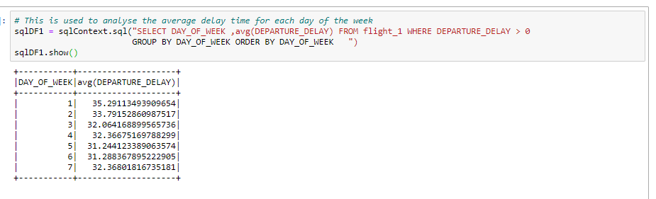
What would be the best day of the week the day the passenger can choose to fly so that he/she can avoid delays in their journeys?

Slide 22
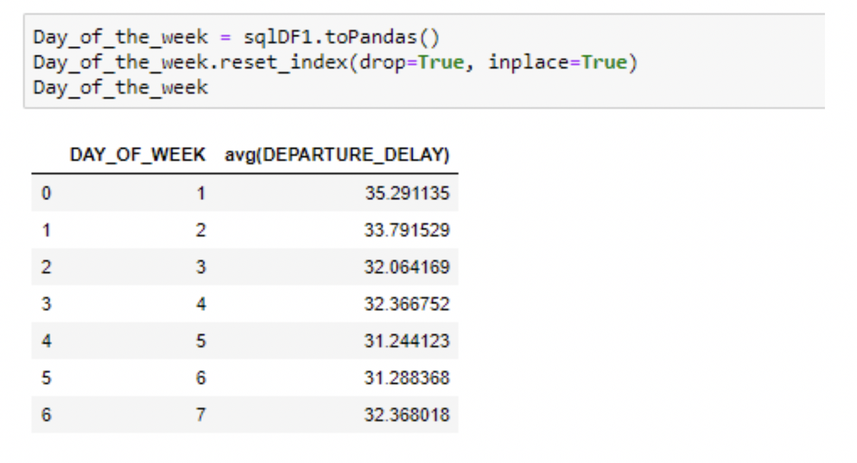
Conti..

Slide 23
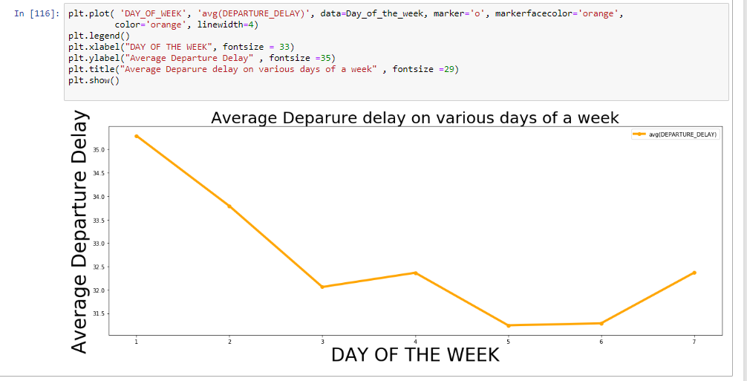
Visualizations

Slide 24
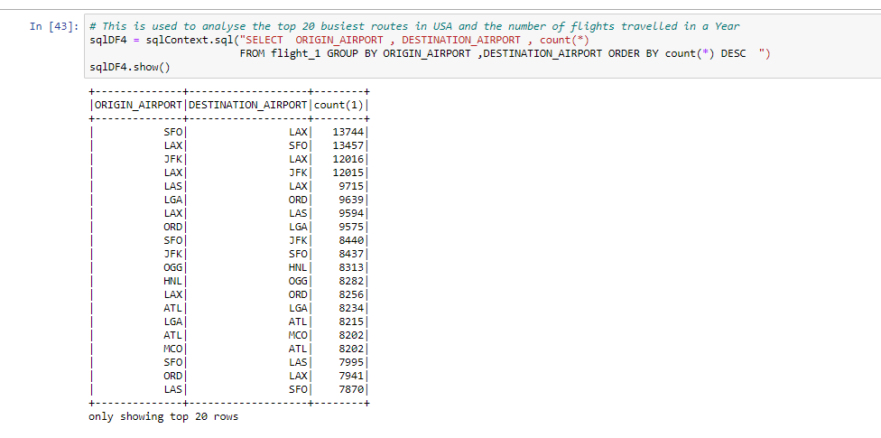
Analyzing the busiest routes in USA

Slide 25
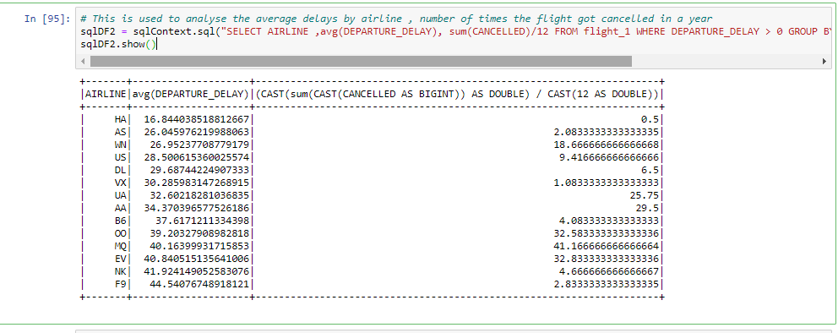
Analysing the best Airline

Slide 26
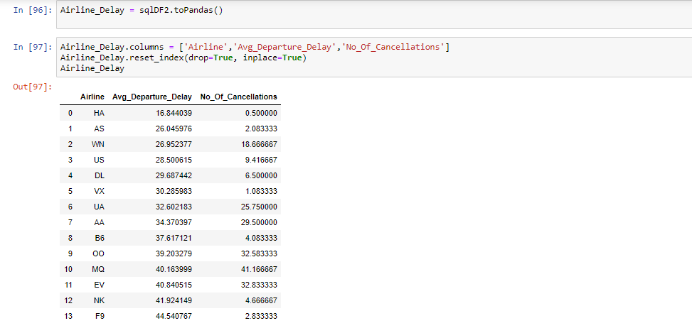
Cont…

Slide 27
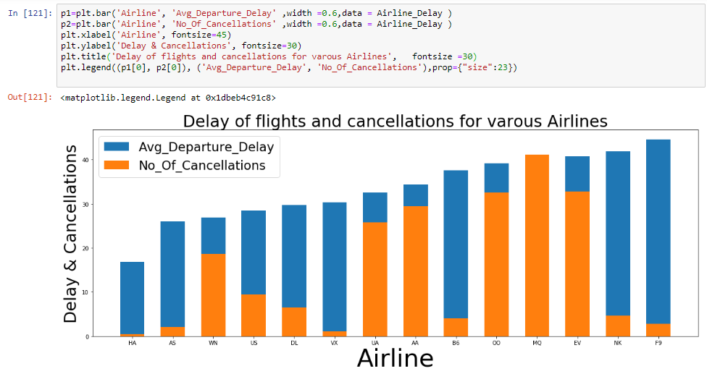
Visualizations

Slide 28
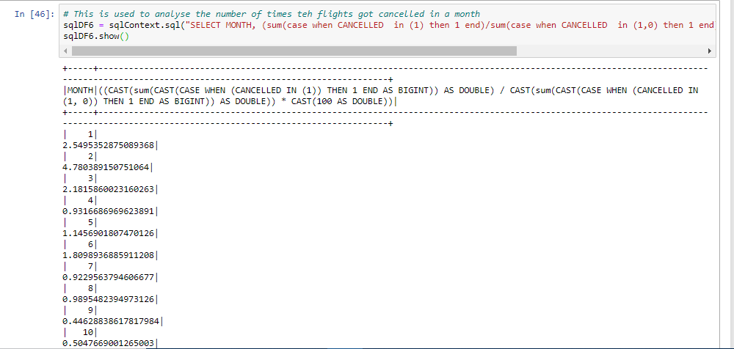
Highest number of cancellations
Notes:
dwede

Slide 29
Cont…

Slide 30
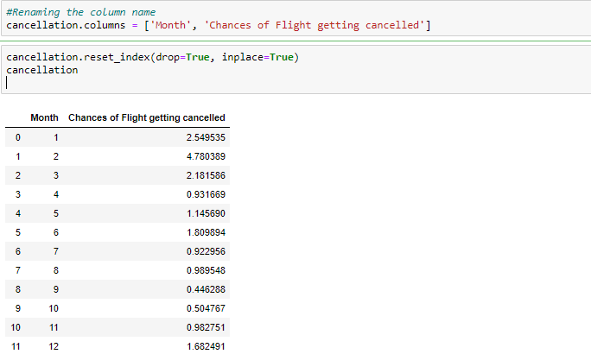
Cont..

Slide 31
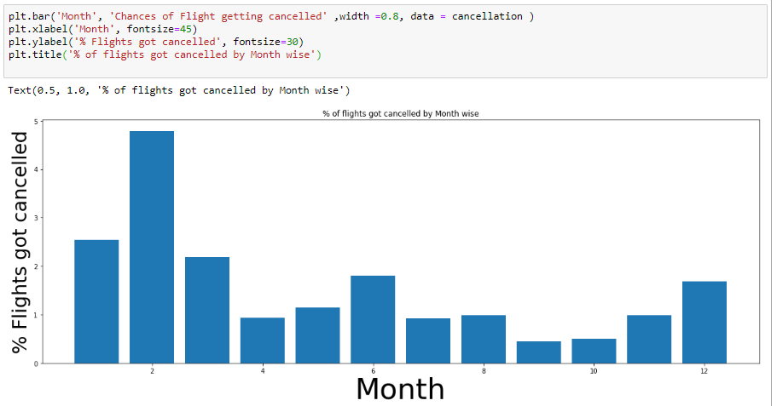
Visualizations

